Slide 1
Aerodynamics
Jaylen, Leo, Jason, Gabriel

Slide 2
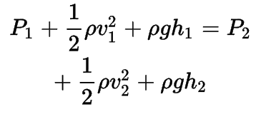
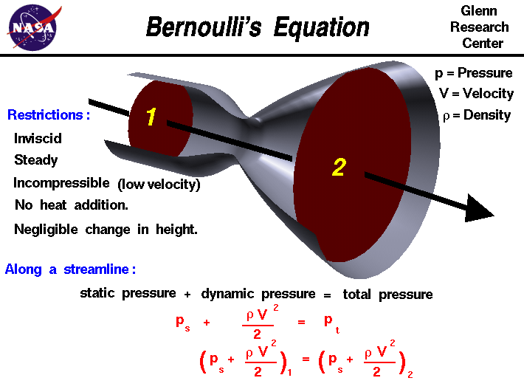
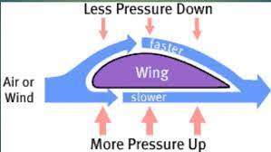
What is aerodynamics
It is the study of air pressure and flow in cars or aeroplanes
Understanding of bernoulli’s equation

Slide 3
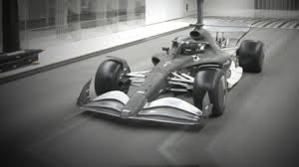
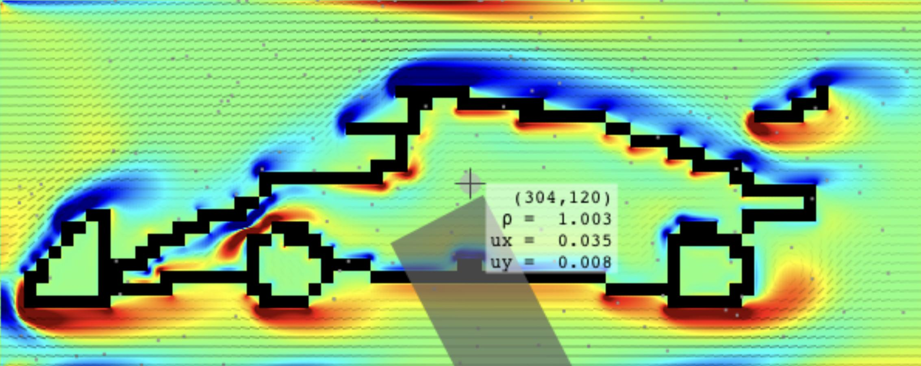
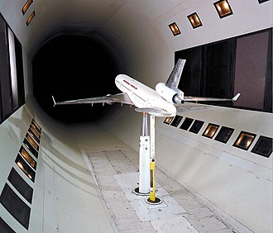
Using a wind tunnel
Wind tunnels are large tubes with air blowing through them which are used to replicate the interaction between air and an object flying through the air or moving along the ground. Researchers use wind tunnels to learn more the aerodynamics of a vehicle.
It is simply a tunnel, with wind blowing into it
The motion of the air can be studied in different ways; smoke or dye can be placed in the air and can be seen as it moves around the object. Coloured threads can also be attached to the object to show how the air moves around it. Special instruments can often be used to measure the force of the air exerted against the object.
Wind tunnels are not always accessible, which is why development teams also use computer simulations in order to maximise the productivity of wind tunnel sessions.

Slide 4
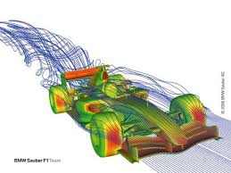
F1 cars design
o achieve the right balance between downforce and drag, F1 teams use a variety of aerodynamic devices, including wings, diffusers, barge boards, and sidepods. These devices work together to create a highly efficient and effective aerodynamic package that helps the car to go faster and perform better on the track.

Slide 5
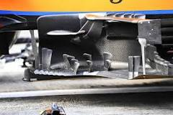

bargeboards
The bargeboards helped position the airflow around the rear of the car differently, turning the flow ahead of the sidepods and the floor for improved performance at lower speeds.

Slide 6
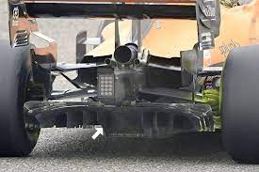
diffusers
DIffuser in an F1 car is the rear part of the bodywork. The air flowing under the car exits through the diffuser as shown in the photo. This action by the diffuser is responsible to create lion's share of downforce.

Slide 7
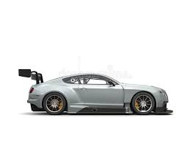
Lift - How do we reduce them
Spoilers
2 ideas to reduce lift:
Decrease pressure by increasing air velocity from under the car
Obstruction of airflow into rough surfaces under the car, preventing lift.
Low vehicle profile
Full undertray
DON'T GO TOO FAST

Slide 8
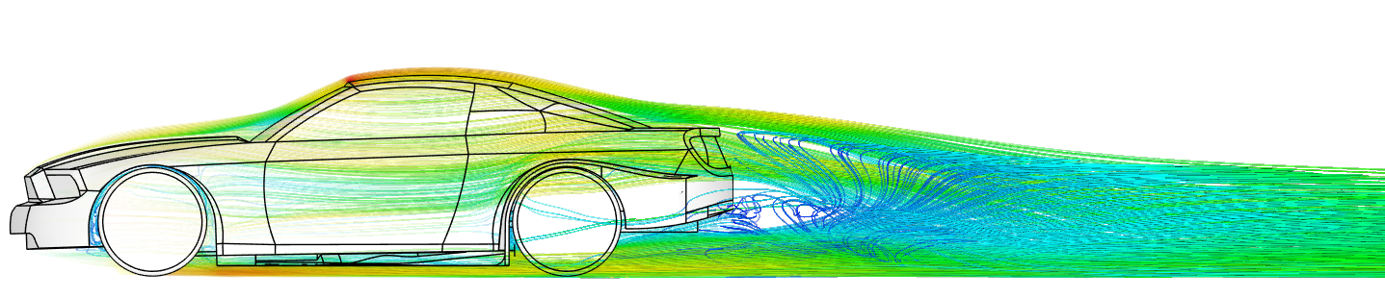

Slide 9
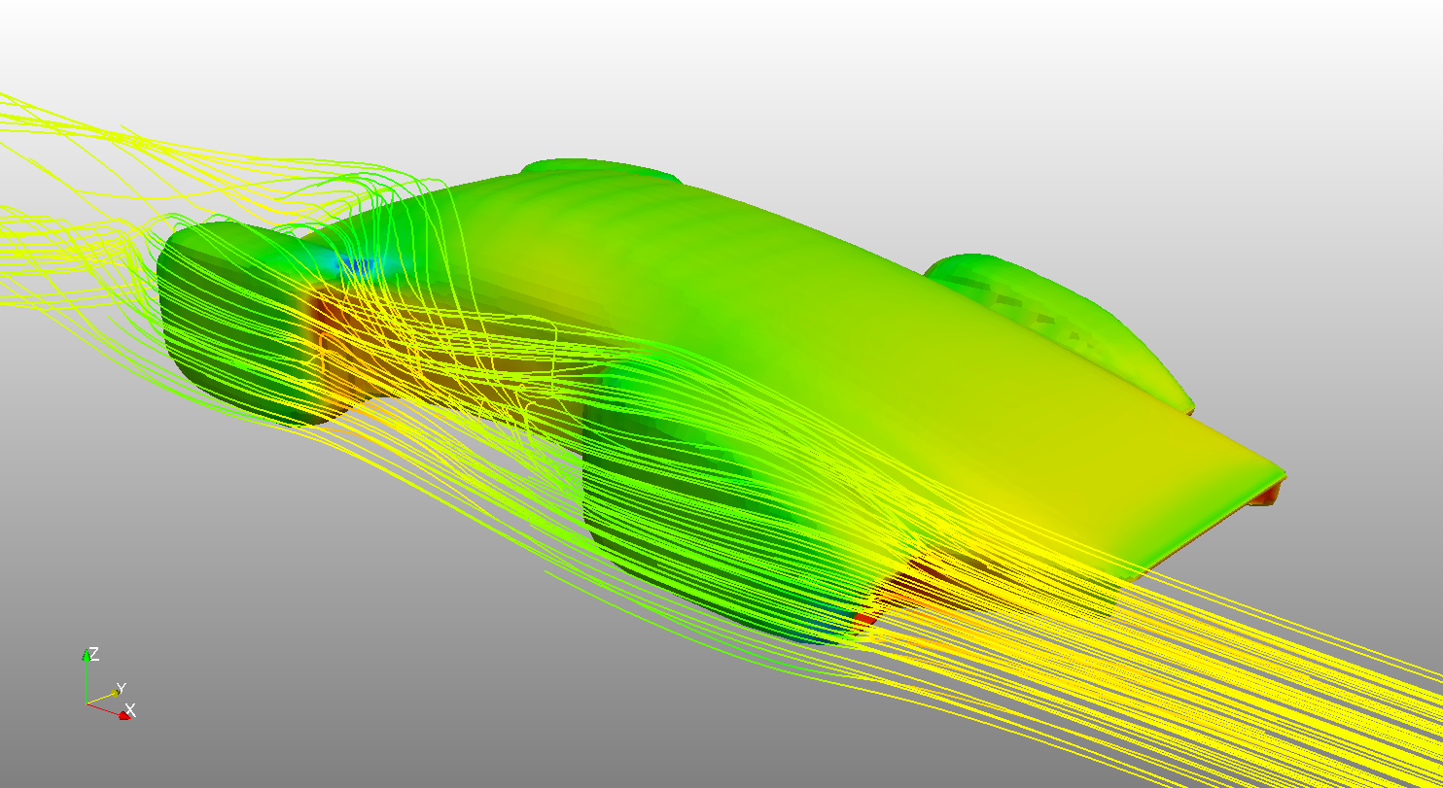

Slide 10
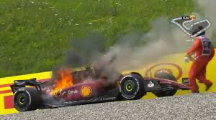
“Aerodynamics is for people who can’t build engines”
Enzo Ferrari

